Slide 1













Lesson
Spark & Azure Databricks
Notes:
Instructor notes
This space has been left deliberately blank.

Slide 2
What is Azure Databricks
The intention of this platform is to provide the ease of deploying a collaborative Machine Learning environment based on Spark that can be used between data scientists, data engineers, and business analysts.
Data can be ingested in a variety of ways into Azure Databricks.
For real-time Machine learning projects, you can ingest data through a wide range of technologies including Kafka, Event Hubs or IoT Hubs.
In addition, you can ingest batches of data using Azure Data Factory from a variety of data stores
Databricks is essentially a wrapper around Apache Spark that simplifies the provisioning and configuration of a Spark cluster in a GUI interface.
Notes:
Instructor notes
Many students are confused between the difference between Hadoop and Spark. It is important to ensure that the students do understand the difference in this lesson.

Slide 3
What is Apache Spark
Apache Spark emerged to provide a parallel processing framework that supports in-memory processing to boost the performance of big-data analytical applications on massive volumes of data.
Why use Azure Databricks
Azure Databricks is a wrapper around Apache Spark that simplifies the provisioning and configuration of a Spark cluster in a GUI interface
Interactive Data Analysis
Used by business analysts or data engineers to analyze and prepare data
Streaming Analytics
Ingest data from technologies such as Kafka and Flume to ingest data in real-time
Machine Learning
Contains a number of libraries that enables a Data Scientist to perform Machine Learning
Azure Databricks components:
Spark SQL and DataFrames
Streaming
Mlib
GraphX
Spark Core API
Notes:
Instructor notes
While this slide highlight the three key uses of Azure Databricks, its key selling point is that it is a one-stop shop for enabling Data Engineering and Data Science collaboration through a simplified environment that helps these roles to ingest, store, prep and train, and model and serve data science projects

Slide 4
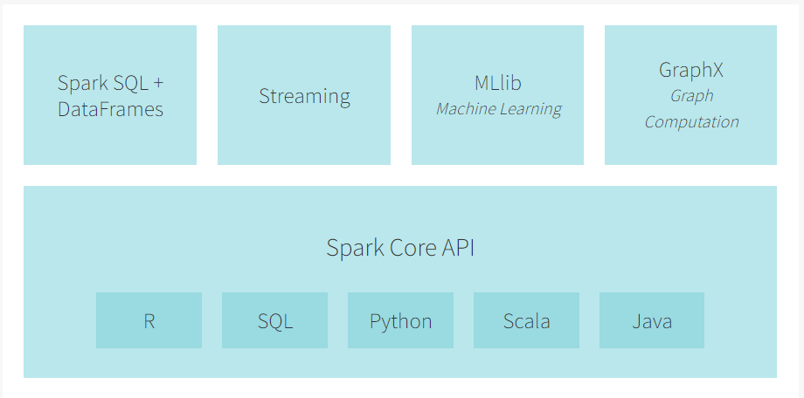
Apache Spark Ecosystem

Slide 5
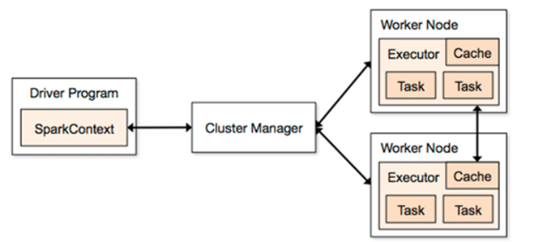
Spark Architecture
https://www.datasciencecentral.com/profiles/blogs/what-is-the-difference-between-hadoop-and-spark

Slide 6
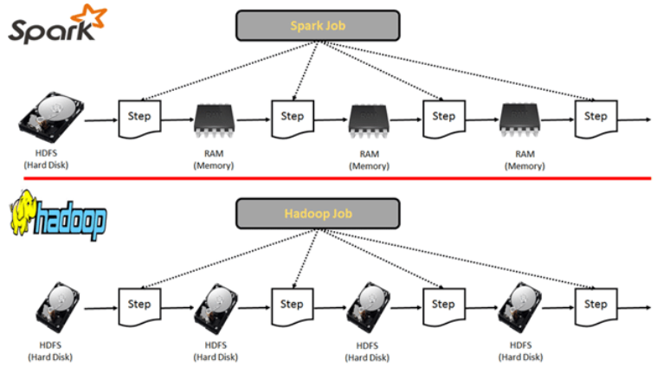
Apache Spark Ecosystem
https://www.datasciencecentral.com/profiles/blogs/what-is-the-difference-between-hadoop-and-spark

Slide 7
The Good
It does in-memory, distributed and iterative computation, which is particularly useful when working with machine learning algorithms.
Other tools might require writing intermediate results to disk and reading them back into memory, which can make using iterative algorithms painfully slow.
Spark offers a data frame abstraction with object-oriented methods for transformations, joins, filters and more.
Lazy execution is especially helpful as it allows you to define a complex series of transformations represented as an object.
PySpark offers a toPandas() method to seamlessly convert Spark DataFrames to Pandas, and its SparkSession.createDataFrame() can do the reverse.
https://thenewstack.io/the-good-bad-and-ugly-apache-spark-for-data-science-work
Notes:
Instructor notes
Many students are confused between the difference between Hadoop and Spark. It is important to ensure that the students do understand the difference in this lesson.

Slide 8
The Bad
Spark is notoriously difficult to tune and maintain.
Jobs failing with out-of-memory errors is very common and having many concurrent users makes resource management even more challenging.
But memory errors and errors occurring within user-defined functions can be difficult to track down
PySpark UDFs are much slower and more memory-intensive than Scala and Java UDFs are (is changing in version 3.0 - 2020)
https://thenewstack.io/the-good-bad-and-ugly-apache-spark-for-data-science-work
Notes:
Instructor notes
Many students are confused between the difference between Hadoop and Spark. It is important to ensure that the students do understand the difference in this lesson.

Slide 9
Querying files
You can use DataFrames to query large data files.
DataFrames are derived from data structures known as Resilient Distributed Datasets (RDDs).
RDDs and DataFrames are immutable distributed collections of data.
Resilient: RDDs are fault tolerant, so if part of your operation fails, Spark quickly recovers the lost computation.
Distributed: RDDs are distributed across the clusters.

Slide 10
DataFrame
A data structure where data is organized into named columns, like a table in a relational database, but with richer optimizations under the hood.
Once created, a DataFrame object comes with methods attached to it.
These methods are operations that you can perform on DataFrames such as filtering, counting, aggregating, and many others
Similar to Pandas DataFrame
Koalas is Pandas replacement inside Databricks

Slide 11
Reading Data in
Azure Databricks.
SQL | DataFrame (Python)
SELECT col_1 FROM myTable | df.select(col("col_1"))
DESCRIBE myTable | df.printSchema()
SELECT * FROM myTable WHERE col_1 > 0 | df.filter(col("col_1") > 0)
..GROUP BY col_2 | ..groupBy(col("col_2"))
..ORDER BY col_2 | ..orderBy(col("col_2"))
..WHERE year(col_3) > 1990 | ..filter(year(col("col_3")) > 1990)
SELECT * FROM myTable LIMIT 10 | df.limit(10)
display(myTable) (text format) | df.show()
display(myTable) (html format) | display(df)
Notes:
Instructor notes
This slide is intended to show similes between the SQL language with the Python language. Both of which can be used in Azure Databricks

Slide 12
Table management
A managed table is a table that manages both the actual data and the metadata.
In this case, a ‘DROP TABLE’ command removes both the metadata for the table as well as the data itself.
Unmanaged tables manage the metadata from a table, while the actual data is managed separately, often backed by a blob store like the Azure Blob or S3.
Dropping an unmanaged table drops only the metadata associated with the table while the data itself remains in place.

Slide 13
Big Data File Types
Data may arrive in your data lake in a human readable format like JSON or XML, or as a CSV file.
Using those raw formats is terribly inefficient.
Those file formats cannot be stored in a parallel manner.
ORC, Parquet, and Avro are machine-readable binary formats.
Files stored in these formats can be split across multiple disks: scalability and parallel processing.
You cannot split JSON, CSV and XML files
https://www.datanami.com/2018/05/16/big-data-file-formats-demystified/

Slide 14
Apache Parquet
Column based format: highly compressed and splittable.
Column metadata is stored at the end of the file: fast, one-pass writing.
Especially adept at analyzing wide datasets with many columns.
Binary data is organized by “row group.” For each row group, the data values are organized by column.
Parquet is a good choice for read-heavy workloads: Spark.
Schema evolution in the Parquet file type is supported.

Slide 15
Apache Avro
Row based format
The data definition is stored in JSON format while the data is stored in binary format, minimizing file size and maximizing efficiency.
Avro features robust support for schema evolution by managing added fields, missing fields, and fields that have changed.
Avro is a relatively compact option for both persistent data storage and wire transfer.
Avro is typically the format of choice for write-heavy workloads given its easy to append new rows.
Often used by Apache Kafka and Nifi (streaming)
Useful for conversions between Spark and Pandas, R, Tensorflow

Slide 16
Apache ORC
Row-columnar based
Highly efficient for compression and storage.
Allows for parallel processing across a cluster, and the columnar format allows for skipping of unneeded columns for faster processing and decompression.
ORC files can store data more efficiently without compression than compressed text files.
Like Parquet, ORC is a good option for read-heavy workloads.

Slide 17
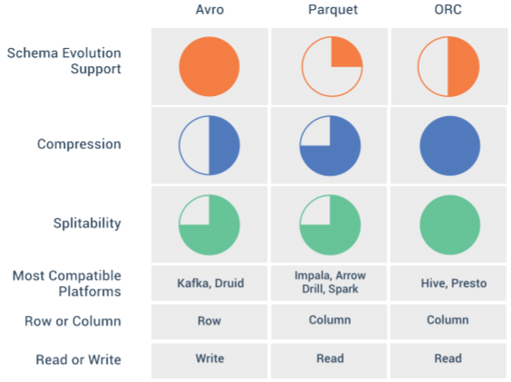
Big Data File Types - Comparison

Slide 18
Grabación Webinar
Introducción a Spark SQL y Spark Streaming para profesionales de bases de datos
Viernes 15/05/2020
https://www.youtube.com/watch?v=k6H9gI0OWy8

Slide 19
Notes:
Instructor notes
This space has been left deliberately blank.

